Slide 1
Watson

Slide 2
Overview

Slide 3
Watson
Watson APIs/Services
Watson Products:
  Watson Virtual Agent
  Watson Explorer
  Watson Analytics
  Watson Knowledge Studio
Focus areas
Built with Watson
https://www.ibm.com/watson/developercloud/
http://www.ibm.com/watson/products.html

Slide 4
APIs

Slide 5
Watson Services (Watson Developer Cloud)
Language
  AlchemyLanguage
  Conversation
  Document Conversion
  Language Translator
  Natural Language Classifier
  Personality Insights
  Retrieve and Rank
  Tone Analyzer
Speech
  Speech to Text
  Text to Speech
Vision
  Visual Recognition
Data Insights
  AlchemyData News
  Discovery
  Tradeoff Analytics
Embodied Cognition
  Project Intu

Slide 6
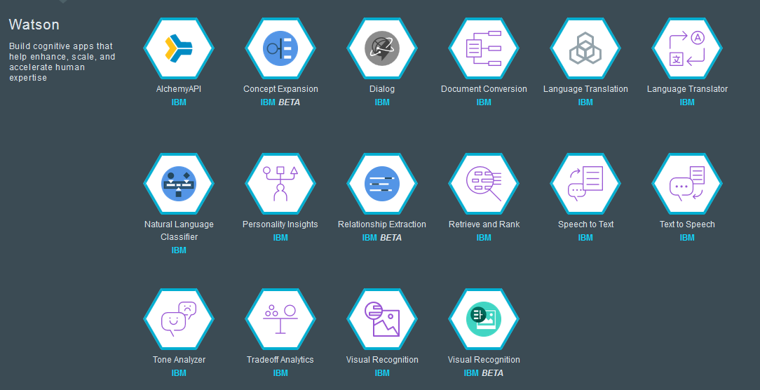
Watson APIs on Bluemix (IBM CIO)

Slide 7
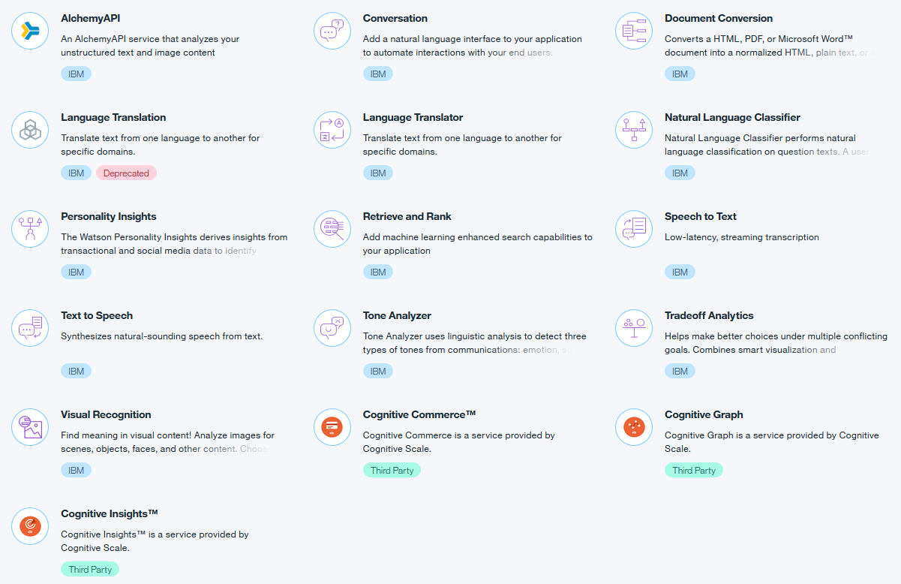
Watson APIs on Bluemix (US South)

Slide 8
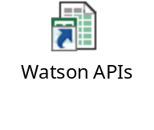
APIs/Services on different environment
APIs/Services website
Bluemix IBM CIO
Bluemix US South

Slide 9
Watson Products

Slide 10
Watson Virtual Agent
https://www.ibm.com/marketplace/cloud/cognitive-customer-engagement/us/en-us
IBM® Watson™ Virtual Agent is a set of preconfigured cognitive components based on the IBM Watson Conversation service. By configuring the virtual agent with your company's information, you can quickly implement an automated chat bot that enables your customers to achieve their goals.
Application extended from Watson API Conversation
(from Watson Engagement Advisor)

Slide 11
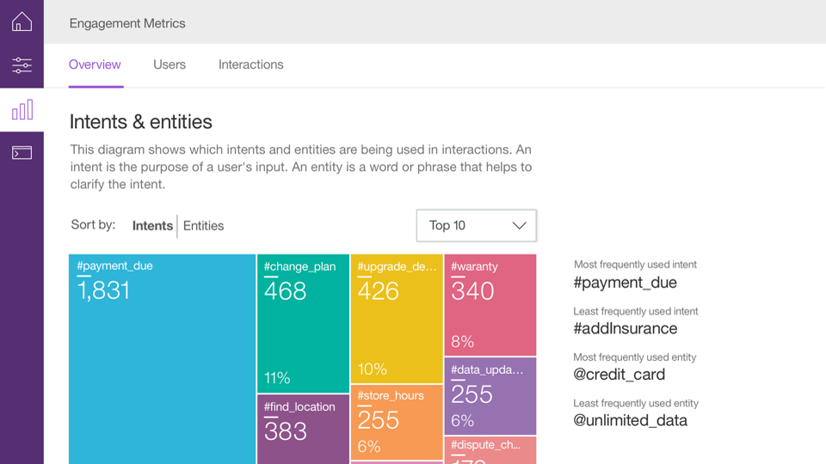
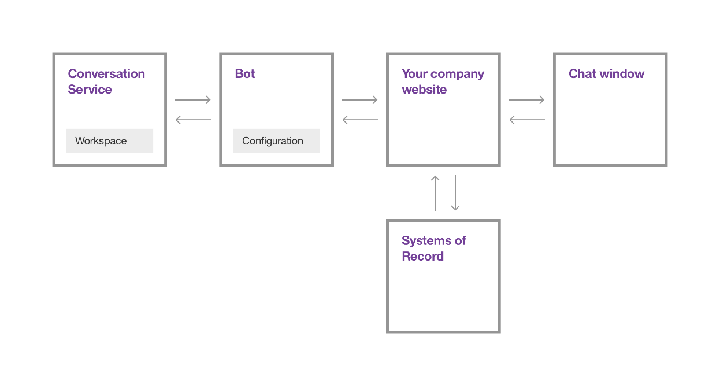

Slide 12
Watson Explorer
https://www.ibm.com/marketplace/cloud/content-analytics/us/en-us
"Watson Explorer is a gateway to us to analyze all kinds of data without the expensive process of data management and ETL and moving the data around.“
Watson Explorer is a cognitive search and content analysis platform that gives you access to insights from all the data you care about, so you can drive business performance and growth. Search and analyze structured, unstructured, internal, external and public content to uncover trends and patterns that improve decision-making, customer service and ROI. Leverage built-in machine learning, natural language processing and next-gen APIs to unlock hidden value in ALL your data. Gain a secure 360-degree view of customers, in context, to deliver superior experiences.
from Data Explorer ← ViviSimo, enterprise level search engine

Slide 13
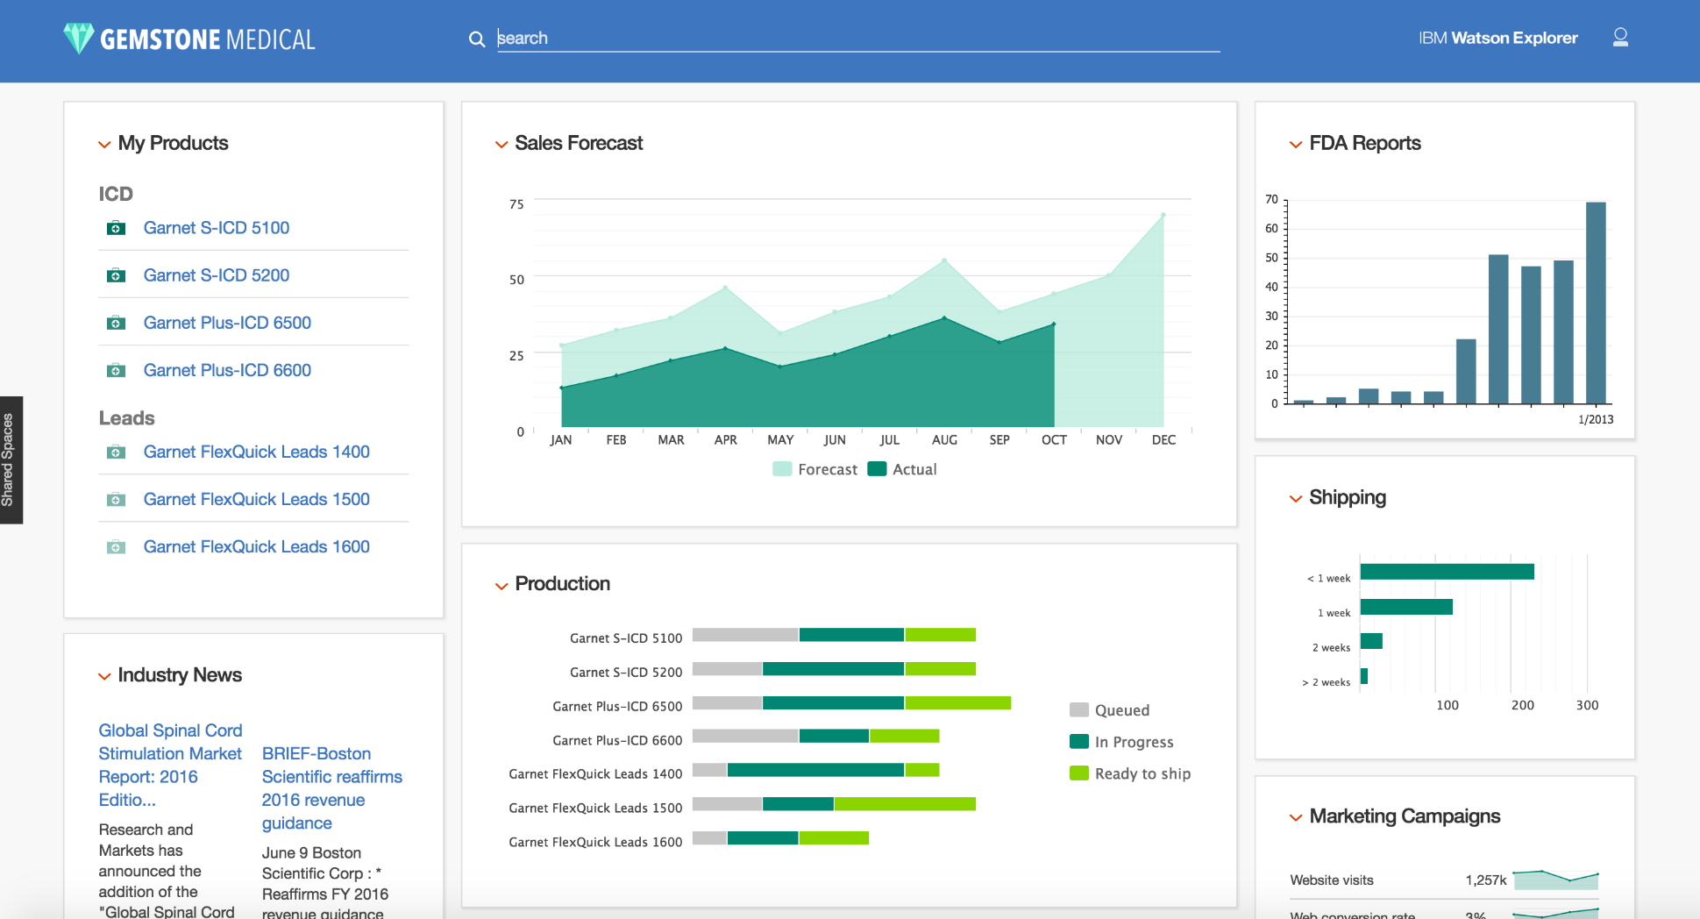

Slide 14
Watson Analytics
https://www.ibm.com/marketplace/cloud/watson-analytics/us/en-us
"Watson Analytics empowers every type of person within Legends to harness data more effectively.“
Product Site:
https://watson.analytics.ibmcloud.com

Slide 15
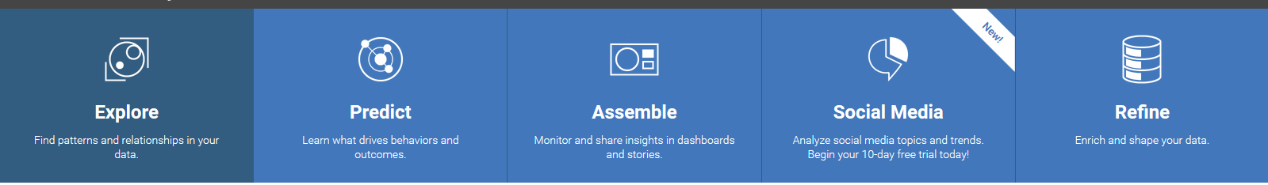

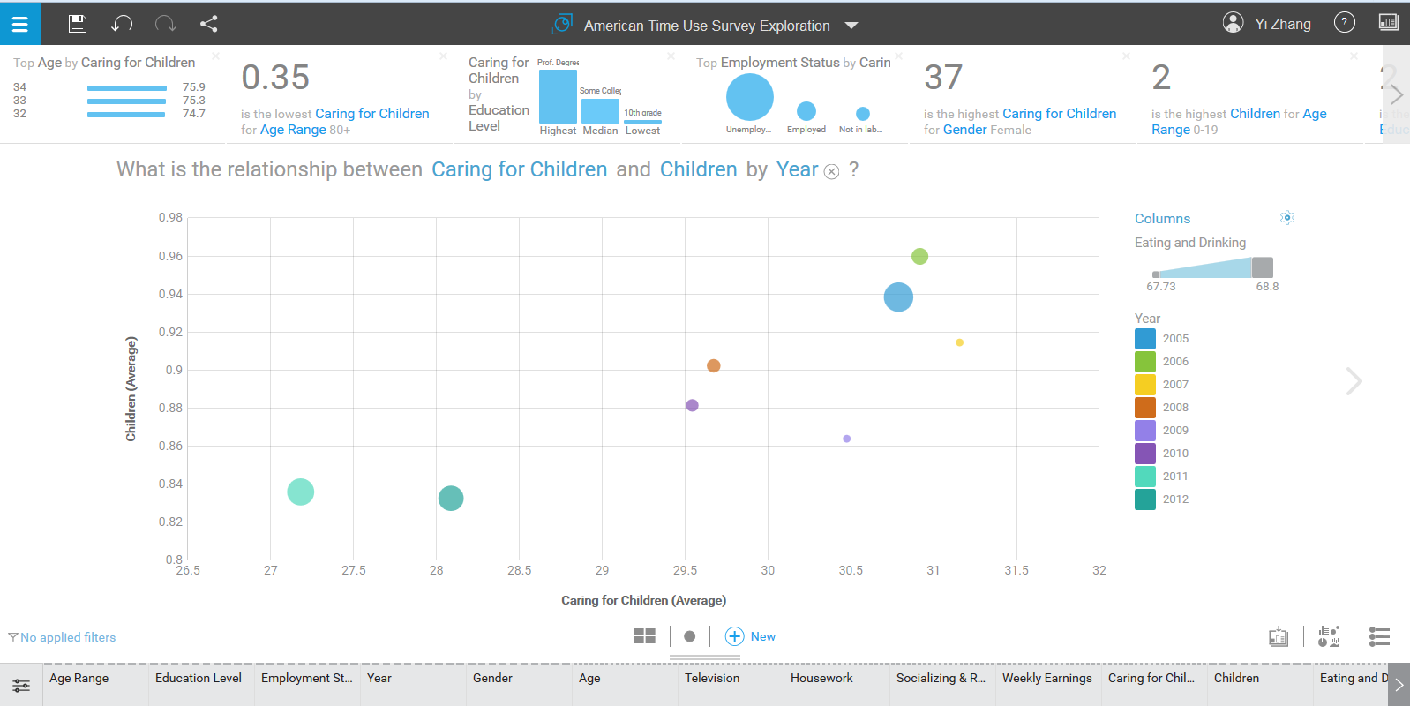
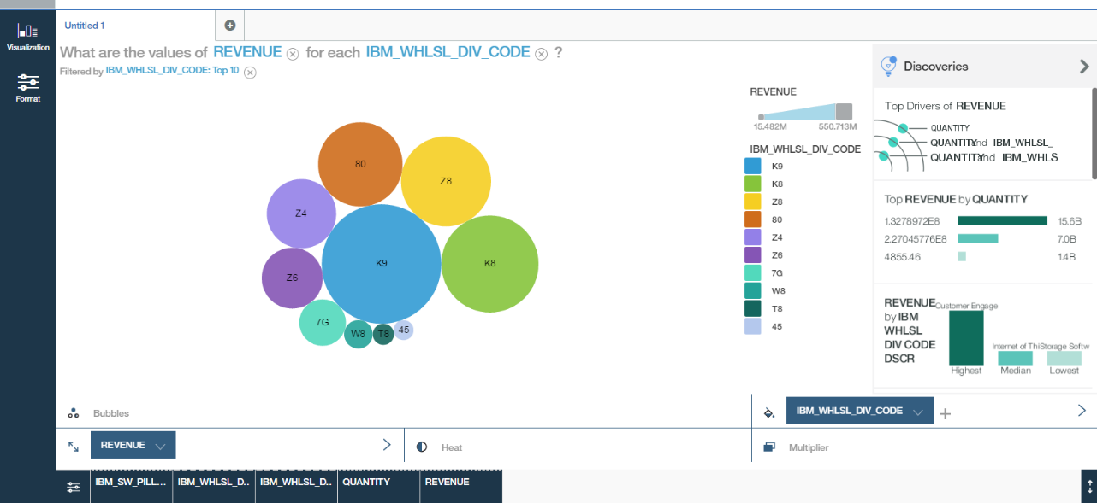
Public IBM Watson Analytics
Watson Analytics@IBM
more data analysis features
dashboard building on Display

Slide 16
Watson Knowledge Studio
https://www.ibm.com/marketplace/cloud/supervised-machine-learning/us/en-us
IBM Watson Knowledge Studio is a cloud-based application that enables developers and domain experts to collaborate and create custom annotator components for unique industries. These annotators can identify mentions and relationships in unstructured data and be easily administered throughout their lifecycle using one common tool. Annotator components can be deployed directly to IBM Watson Explorer and Alchemy Language on IBM Watson Developer Cloud.
from CCI (Cognos Consumer Insight) based on Apache UIMA

Slide 17
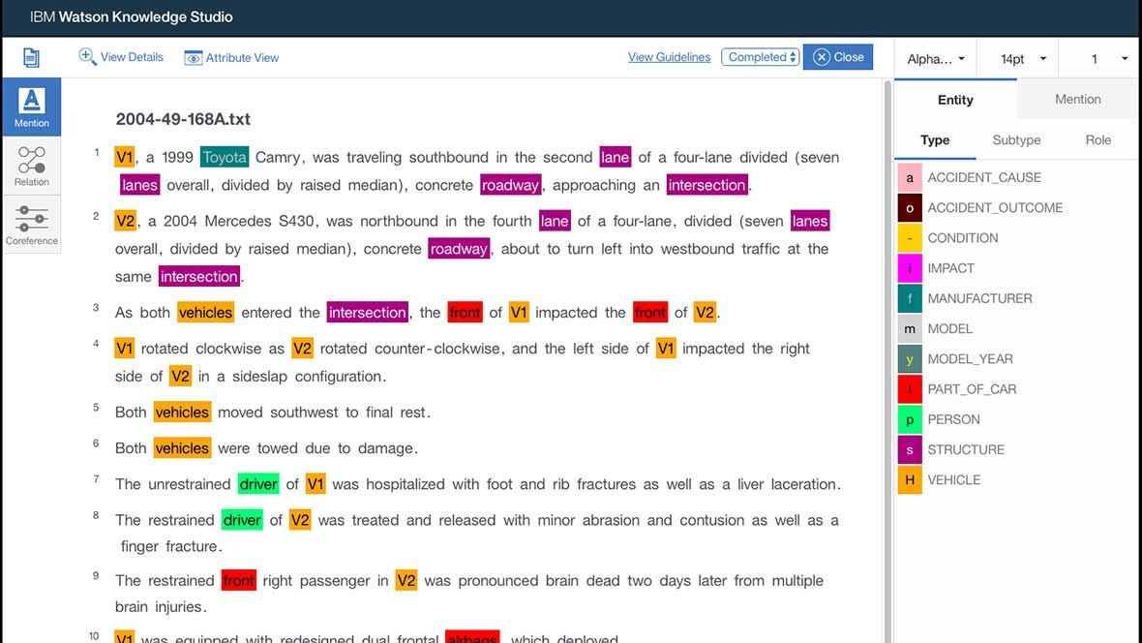

Slide 18
More Knowledge about Watson

Slide 19



Answering questions is not about searching for documents
Search engine
vs.
IBM Watson
Has question
Asks a question
Distills to 2-3 keywords
Understands question
Finds documents containing keywords
Produces possible answers and evidence
Delivers documents based on popularity
Analyzes evidence
Reads documents
Computes confidence
Finds answers
Delivers response, evidence and confidence
Finds and analyzes evidence
Considers answers and evidence
© 2015 International Business Machines Corporation
Notes:
On the left, we have the standard search paradigm. On the right, we have the Watson paradigm.
Consider how we have been “trained” to search. We have a question in mind, and we distill it down to some small number of keywords, which we enter into the search engine. The search engine returns us some large number of links that contain documents, that have those key words. The results are based on popularity and SEO. We then have to sift through that information, reading, and figuring out whether or not the right answer is in there. If not, we have to start over.
Now consider Watson. We have a question in mind. We simply provide Watson with the question, in natural language, as a regularly formed English sentence! Watson understands the question. It analyzes its corpus of information to determine possible candidate answers to the question, along with supporting evidence. It analyzes the evidence and determines a confidence level. Watson provides you with the best answer or answers to the question, along with the evidence!

Slide 20
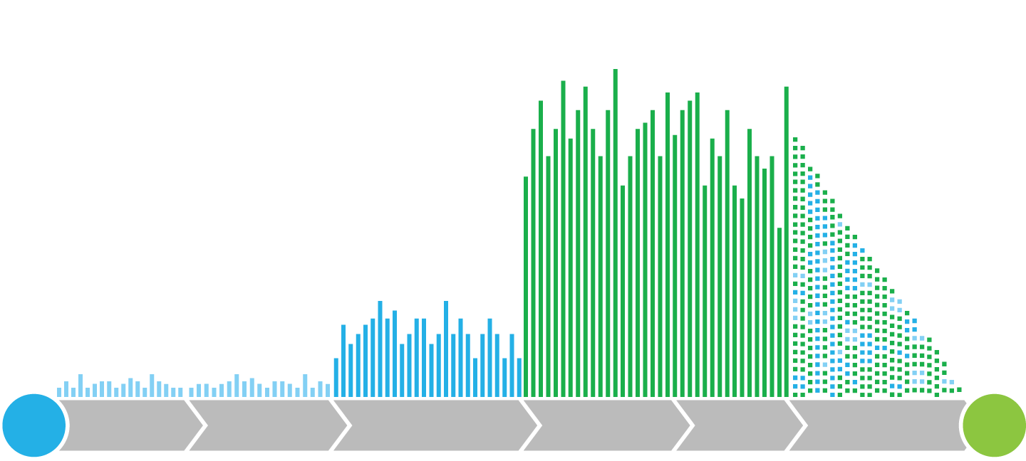
Watson’s Pipelines
Multiple interpretations
Hundreds of answer sources
Primary search
Candidate answer generation
Tens of thousands of evidence sources and scores
Answer scoring
Evidence retrieval
Deep evidence scoring
Learned models
Combine and weigh evidence
Natural language processing
Information retrieval
Knowledge representation and reasoning
Deep analytics
Machine learning
?
!
Parallel and distributed computing
Question
Inquiry analysis
Decomposition
Hypothesis generation
Hypothesis and evidence scoring
Synthesis
Final confidence merging and ranking
Answer
© 2015 International Business Machines Corporation
© 2015 International Business Machines Corporation
Notes:
Main point: Watson works in different ways than we’ve grown accustomed to in the era of programatic computing. It finds its responses not through business rules or decision trees, but by hypothesizing, gathering evidence to support or refute those hypotheses, weighing the relative strength of evidence for possible responses, and then sharing its results with full transparency of evidence for the user to consider.
Looking at this step by step:
1. When a question is first presented to Watson, it parses the question to extract the major features of the question.
2. It generates a set of hypotheses by looking across the body of data for passages that have some potential for containing a valuable response.
3. It performs a deep comparison of the language of the question and the language of each potential response by using various reasoning algorithms. This step is challenging. There are hundreds of reasoning algorithms, each of which does a different comparison. For example, some look at the matching of terms and synonyms, some look at the temporal and spatial features, and some look at relevant sources of contextual information.
4. Each reasoning algorithm produces one or more scores, indicating the extent to which the potential response is inferred by the question based on the specific area of focus of that
algorithm.
5. Each resulting score is then weighted against a statistical model that captures how well that algorithm did at establishing the inferences between two similar passages for that
domain during the “training period” for Watson. That statistical model can then be used to summarize a level of confidence that Watson has about the evidence that the candidate
answer is inferred by the question.
6. Watson repeats this process for each of the candidate answers until it can find responses that surface as being stronger candidates than the others.
Addition descriptive explanation from the ML White Paper:
When a question is first presented to Watson, it parses the question to pull out the major features of the question. It then generates a set of hypotheses by looking across the corpus for passages that have some potential for containing the correct answer. It then performs a deep comparison of the language of the question and the language of each potential answer using a variety of reasoning algorithms.
This is the hard part. There are hundreds of reasoning algorithms – each of which does a different kind of comparison. Some look at the matching of terms and synonyms. Some look at the temporal and spatial features. Some look at relevant sources of contextual information. And so forth.
Each of these reasoning algorithms will produce one or more scores indicating the extent to which the potential answer is inferred by the question based on that algorithm’s specific area of focus. Each of the resulting scores is then weighted against a statistical model that captures how well that algorithm has done at establishing the inferences between two similar passages for that domain during Watson’s “training period.” That statistical model can then be used to summarize a level of confidence Watson has about the evidence that the candidate answer is inferred by the question.
And it does this for each of the candidate answers until it is able to find one that surfaces as being a stronger candidate than the others.
Of paramount importance to the operation of Watson is a knowledge corpus. This corpus consists of all kinds of unstructured knowledge. Example of knowledge that gets ingested into the corpus are text books, guidelines, how-to manuals, FAQs, benefit plans, and news feeds to mention only a few. Prior to any of this, Watson will have ingested the corpus – going through the entire body of content to get it into a form that is easier to work with. The ingestion process will also curate the content – that is, making sure the corpus contains appropriate content; sifting out the articles or pages that are out of date or irrelevant, or that come from potentially unreliable sources As we indicated, some of the reasoning algorithms focus on spatial and temporal features of the passage. This turns out to be critical to disambiguating a tremendous amount of what humans say and write. When we say, “Find me pizza” it is just taken for granted that we mean something nearby. But what is nearby is always a relative thing. In other cases, spatial relationships show up relative to geographic markers – neighborhood in a city, or a state in a country. Likewise, temporal features are also present in the context of much of what we write. When we say, “Get cheese from the store on your way home” there is an inferred time frame. Presumably the writer and the recipient have a shared, contextual understanding of when they will be on their way home.

Slide 21
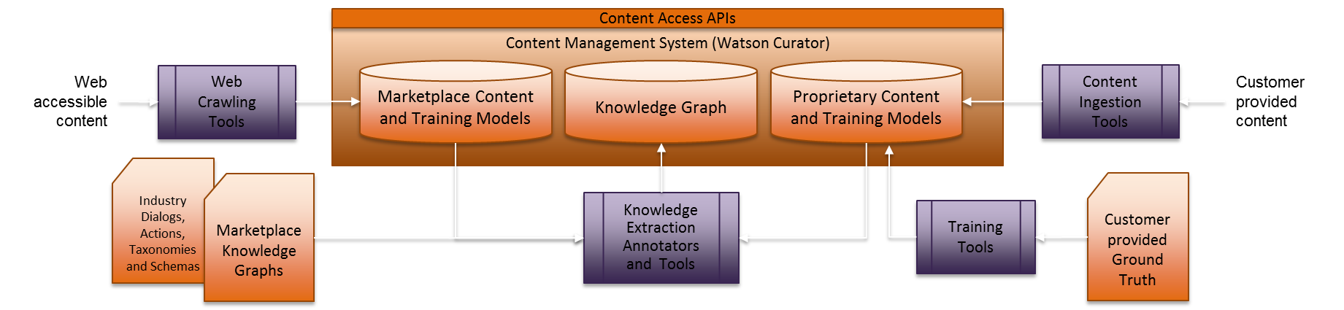
Corpus Management
Content repository (aka Watson Curator, and therefore includes curation utilities) -- with support for versioning and management for both literature and structured resources
Repository APIs
Connectors (including those being delivered by Watson Curator, but also any others that we bring to the table)
Industry content (licensed and open content titles), ontologies / knowledge graphs, procedures, visualizations
Annotators and training utilities –
Document formats (schema and layout) and formatting utilities (including conversion, normalization, validation, health checks)
Conversational state/history management
Log data
Digital exhaust
© 2015 International Business Machines Corporation

Slide 22














Watson Developer Cloud
Message Resonance
Personality Insights
Concept Expansion
Build with Watson
Watson Services are available on IBM’s Bluemix platform
Machine Translation
Relationship Extraction
Speech to Text
A collection of REST APIs and SDKs that use cognitive computing to solve complex problems…
Question and Answer
Visualization Rending
Text to speech
NEW
Visual Recognition
Concept Insights
Tradeoff Analytics
© 2015 International Business Machines Corporation

Slide 23




New features with AlchemyAPI
Language
• Entity Extraction
• Sentiment Analysis
• Keyword Extraction
• Concept Tagging
• Relation Extraction
• Taxonomy Classification
• Author Extraction
• Language Detection
• Text Extraction
• Microformats Parsing
• Feed Detection
• Linked Data Support
• Profanity Detection
• Knowledge Graph
Vision
Image Tagging
Facial Recognition
Link Extraction
Image Similarity
Natural Scene OCR
Data
• News API
• Storage “Buckets”
• Answers
© 2015 International Business Machines Corporation
Notes:
IBM built the Bluemix platform to not only help organizations of all sizes move more quickly and extend existing investments in apps and infrastructure, but to build the new types of apps and services that use data and mobility to engage both users, and the physical world around us, in new and exciting ways.

Slide 24
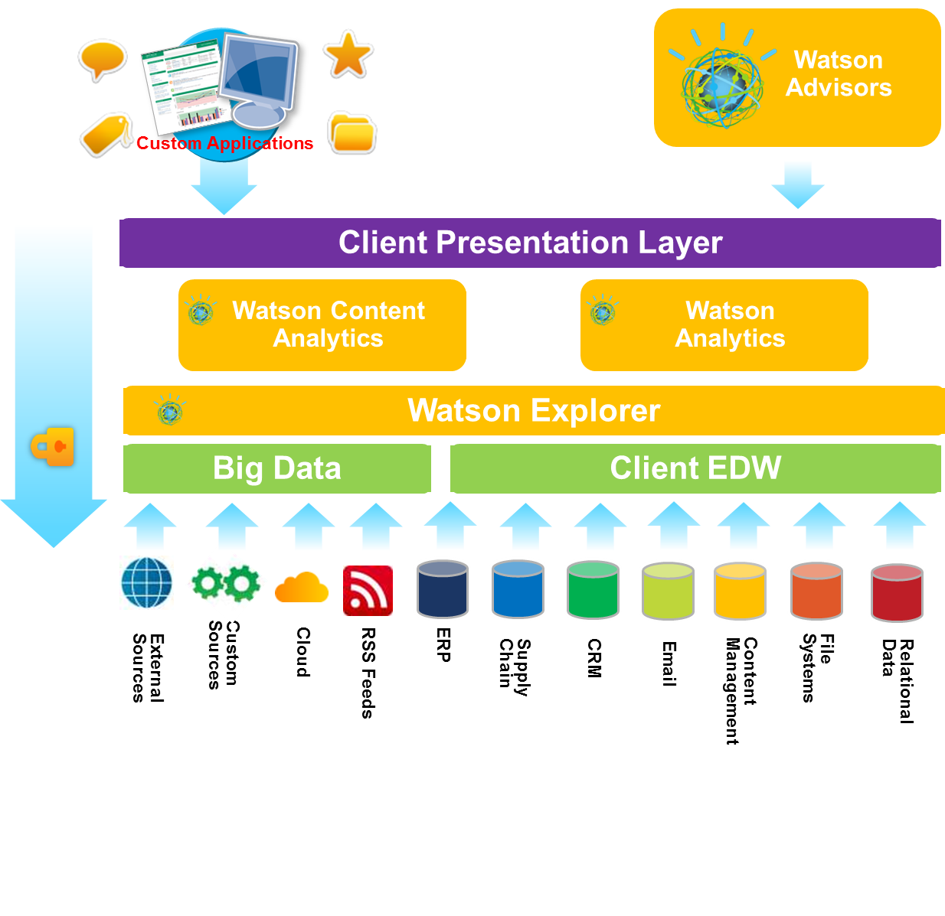
Cognitive & Analytics Logical Architecture Example
© 2015 International Business Machines Corporation

Slide 25

Thank You!

